Slide 1
C++
Md. Abdur Rahman
Senior Computer Scientist
Centre for Advanced in Research in Sciences (CARS)
University of Dhaka

Slide 2
For Loop
The C++ for loop is used to iterate a part of the program several times.
If the number of iteration is fixed, it is recommended to use for loop than while or do-while loops.
#include <iostream>
using namespace std;
int main()
{
for(int i=1;i<=10;i++){
cout<<i <<"\n";
}
}

Slide 3
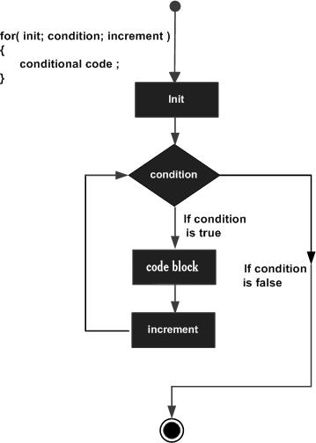
For Loop

Slide 5
Nested For Loop
we can use for loop inside another for loop, it is known as nested for loop
The inner loop is executed fully when outer loop is executed one time
So if outer loop and inner loop are executed 4 times, inner loop will be executed 4 times for each outer loop i.e. total 16 times.

Slide 6
Nested For Loop
#include <iostream>
using namespace std;
int main ()
{
for(int i=1;i<=3;i++){
for(int j=1;j<=3;j++){
cout<<i<<" "<<j<<"\n";
}
}
}

Slide 7
Infinite For Loop
If we use double semicolon in for loop, it will be executed infinite times.
#include <iostream>
using namespace std;
int main ()
{
for (; ;)
{
cout<<"Infinitive For Loop";
}
}

Slide 8
Execution Trace
i
0
for (int i = 0; i < 3; ++i) { cout << "i is " << i << endl;
}
cout << "all done" << endl;

Slide 9
Execution Trace
i
0
for (int i = 0; i < 3; ++i) { cout << "i is " << i << endl;
}
cout << "all done" << endl;

Slide 10
Execution Trace
i
0
for (int i = 0; i < 3; ++i) { cout << "i is " << i << endl;
}
cout << "all done" << endl;
i is 0

Slide 11
Execution Trace
i
0
for (int i = 0; i < 3; ++i) { cout << "i is " << i << endl;
}
cout << "all done" << endl;
i is 0

Slide 12
Execution Trace
i
1
for (int i = 0; i < 3; ++i) { cout << "i is " << i << endl;
}
cout << "all done" << endl;
i is 0

Slide 13
Execution Trace
i
1
for (int i = 0; i < 3; ++i) { cout << "i is " << i << endl;
}
cout << "all done" << endl;

Slide 14
Execution Trace
i
1
for (int i = 0; i < 3; ++i) { cout << "i is " << i << endl;
}
cout << "all done" << endl;
i is 0
i is 1

Slide 15
Execution Trace
i
1
for (int i = 0; i < 3; ++i) { cout << "i is " << i << endl;
}
cout << "all done" << endl;
i is 0
i is 1

Slide 16
Execution Trace
i
2
for (int i = 0; i < 3; ++i) { cout << "i is " << i << endl;
}
cout << "all done" << endl;
i is 0
i is 1

Slide 17
Execution Trace
i
2
for (int i = 0; i < 3; ++i) { cout << "i is " << i << endl;
}
cout << "all done" << endl;
i is 0
i is 1

Slide 18
Execution Trace
i
2
for (int i = 0; i < 3; ++i) { cout << "i is " << i << endl;
}
cout << "all done" << endl;
i is 0
i is 1
i is 2

Slide 19
Execution Trace
i
2
for (int i = 0; i < 3; ++i) { cout << "i is " << i << endl;
}
cout << "all done" << endl;
i is 0
i is 1
i is 2

Slide 20
Execution Trace
i
3
for (int i = 0; i < 3; ++i) { cout << "i is " << i << endl;
}
cout << "all done" << endl;
i is 0
i is 1
i is 2

Slide 21
Execution Trace
i
3
for (int i = 0; i < 3; ++i) { cout << "i is " << i << endl;
}
cout << "all done" << endl;
i is 0
i is 1
i is 2

Slide 22
Execution Trace
i
3
for (int i = 0; i < 3; ++i) { cout << "i is " << i << endl;
}
cout << "all done" << endl;
i is 0
i is 1
i is 2
all done

Slide 23
While loop
while loop is used to iterate a part of the program several times
If the number of iteration is not fixed, it is recommended to use while loop than for loop.
while(condition){
//code to be executed
}

Slide 24
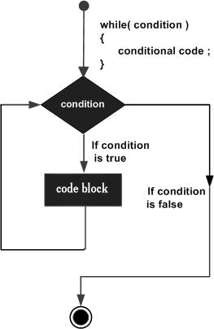
While loop
#include <iostream>
using namespace std;
int main()
{
int i=1;
while(i<=10)
{
cout<<i <<"\n";
i++;
}
}

Slide 25
Nested While Loop Example
#include <iostream>
using namespace std;
int main ()
{
int i=1;
while(i<=3)
{
int j = 1;
while (j <= 3)
{
cout<<i<<" "<<j<<"\n";
j++;
}
i++;
}
}

Slide 26
Infinitive While Loop Example:
We can also create infinite while loop by passing true as the test condition.
#include <iostream>
using namespace std;
int main ()
{
while(true)
{
cout<<"Infinitive While Loop";
}
}

Slide 27
Do-While Loop
do-while loop is used to iterate a part of the program several times.
If the number of iteration is not fixed and you must have to execute the loop at least once, it is recommended to use do-while loop.
do{
//code to be executed
}while(condition);

Slide 28
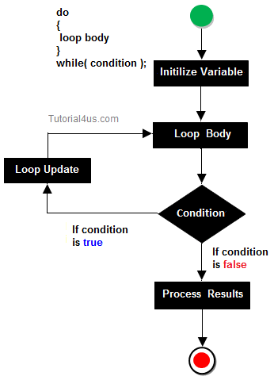
Do-While Loop

Slide 29
Do-While Loop
#include <iostream>
using namespace std;
int main()
{
int i = 1;
do{
cout<<i<<"\n";
i++;
} while (i <= 10) ;
}

Slide 30
Nested do-while Loop
The nested do-while loop is executed fully for each outer do-while loop.
include <iostream>
using namespace std;
int main()
{
int i = 1;
do{
int j = 1;
do{
cout<<i<<"\n";
j++;
} while (j <= 3) ;
i++;
} while (i <= 3) ;
}

Slide 31
Infinitive do-while Loop
if you pass true in the do-while loop, it will be infinitive do-while loop.
do{
//code to be executed
}while(true);
#include <iostream>
using namespace std;
int main()
{
do{
cout<<"Infinitive do-while Loop";
} while(true);
}

Slide 32
Write program to solve the following problems
Display the half pyramid of * using nested-for loop
Display Floyd’s Triangle using nested-for loop
Display the Number Triangle using nested-for loop – I
Display the Number Triangle using nested-for loop – II
* * * * * * * * * *
1 2 2 3 3 3 4 4 4 4 5 5 5 5 5
1 1 2 1 2 3 1 2 3 4 1 2 3 4 5
1 2 3 4 5 6 7 8 9 10

